Slide 1
Parameterized Unit Testing in the Open Source Wild
Wing Lam (U. Illinois)
In collaboration with Siwakorn Srisakaokul, Blake Bassett, Peyman Mahdian and Tao Xie (U. Illinois)
Nikolai Tillman, Jonathan de Halleux (Microsoft Research)

Slide 2
Motivation
Behavioral specifications are useful in static or dynamic software verification
Ex. Code Contracts, JML, or Design by Contract
Postconditions are not commonly written
In 90 projects with 43823 contract clauses, 11355 are postconditions (26%) [Schiller et al. ICSE’14]
T. W. Schiller, K. Donohue, F. Coward, and M. D. Ernst. Case studies and tools for contract specifications. In Proceedings of the 36th International Conference on Software Engineering, pages 596–607. ACM, 2014.
Notes:
Although open source developers use specification languages, they don’t write postconditions often the time
Besides these specifications, developers can write semi formal specifications in form of a special type of unit test like Parameterized Unit Tests

Slide 3
What are Parameterized Unit Tests (PUTs)?
Written in the same manner as traditional unit tests, but taking parameters
Very similar to code that developers are used to writing, while providing stronger test oracles
Decompose specification into small scenario based pieces, asserting expected behavior under a certain scenario

Slide 4
Example of Parameterized Unit Test
Asserts properties about many Set instances, beyond just a few hard-coded instances as in Conventional Unit Tests (CUTs)
[PexMethod] public static void testAddExisting1(Set s, int i) { PexAssume.IsNotNull(s); PexAssume.IsTrue(s.Contains(i)); int oldSize = s.Size; s.Add(i); PexAssert.AreEqual(s.Size, oldSize); }
Describes Set’s size change after adding an element.
Set s is not null and contains i
int i can be any integer

Slide 5
Motivation – Push Example
Code under verification/test, Push of bounded stack storing set of integers
Code Contract:
Contract.Ensures((Contract.OldValue(this.IsFull()) ||
Contract.OldValue(this.IsMember(e))) ||
(this.IsMember(e) &&
Contract.OldValue(this.GetSize()) + 1 == this.GetSize()));

Slide 6
Motivation – Push Example
Code under verification/test, Push of bounded stack storing set of integers
Code Contract:
Contract.Ensures((Contract.OldValue(this.IsFull()) ||
Contract.OldValue(this.IsMember(e))) ||
(this.IsMember(e) &&
Contract.OldValue(this.GetSize()) + 1 == this.GetSize()));
PUT:

Slide 7
Motivation – Pop Example
Code under verification/test, Pop of bounded stack storing set of integers
Code Contract: PUT:

Slide 8
Motivation – Pop Example
Code under verification/test, Pop of bounded stack storing set of integers
Code Contract: PUT:
???

Slide 9
Motivation – Pop Example
Code under verification/test, Pop of bounded stack storing set of integers
Code Contract: PUT:
???
Notes:
Hopefully we have convinced you that PUTs are a good way for formal methods to be applied in practice.
We have found that PUTs are widely used in practice

Slide 10
Parameterized Unit Testing Going Mainstream
Parameterized Unit Tests (PUTs) commonly supported by various test frameworks
.NET: Supported by .NET test frameworks
http://www.mbunit.com/
http://www.nunit.org/ …
Java: Supported by JUnit 4.X
http://www.junit.org/
Generating test inputs for PUTs supported by tools
.NET: Supported by Microsoft Visual Studio 2015 IntelliTest
Formerly Microsoft Research Pex: http://research.microsoft.com/pex/
Java: Supported by Agitar AgitarOne
http://www.agitar.com/

Slide 11
Goal of Our Work
To fill the gap that there exists no study to understand how developers use parameterized unit testing
Empirical study of the use of parameterized unit testing in the open source wild
Suite of analysis tools for analyzing parameterized unit tests and associated software systems
Notes:
Although PUTs are in mainstream, there has been no study to understand how developers use them
Empirical study of the use of parameterized unit testing in the wild
How broadly subjects use parameterized testing, kinds of specifications are often tested, restrictions are placed on inputs, and how developers manage object creation problems
Empirical comparison of contract-based specification and parameterized testing.
Similarities and differences are analyzed and discussed
Suite of analysis tools for the analysis of parameterized unit tests and associated software systems
Allow for the collection of a variety of aspects of the composition and use of parameterized tests in a subject system

Slide 12
Study Setup
Collect open source projects with PUTs written in C# (subjects)
(1) Collect subjects from searchable online source code repositories
(2) Deduplicate subjects obtained multiple times from repositories
(3) Condense multi-project subjects
(4) Filter developer-written PUTs
(5) Categorize subjects into levels of parameterized test usage

Slide 13
Subject Statistics
Subject name | # of PexMethods | # of UnitTestMethods
PexFaultLocalization | 168 | 1221
linqtoroot | 133 | 344
QuickGraph0 | 112 | 1212
concolic-walk | 87 | 1
stringextensions | 67 | 466
isuka | 54 | 300
utilities-net | 44 | 299
henoch | 27 | 170
bbcode | 26 | 16
ConcurrentList | 21 | 27
Identified 33 subjects that contained a high number of PUTs
Total of 839 PUTs in them
…
Notes:
Varies a lot, some subjects write lots of PUTs but not CUTs

Slide 14
Stakeholders of Our Findings
Developers who are writing PUTs
Developers who have not yet written PUTs
Tool developers like ourselves for the analysis tool
PUT framework developers
Researchers
Educators/trainers of software testing

Slide 15
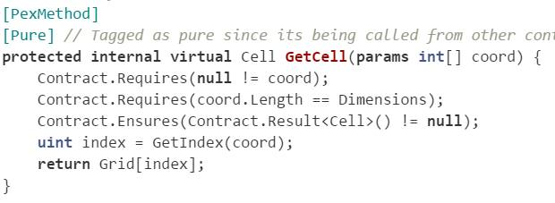
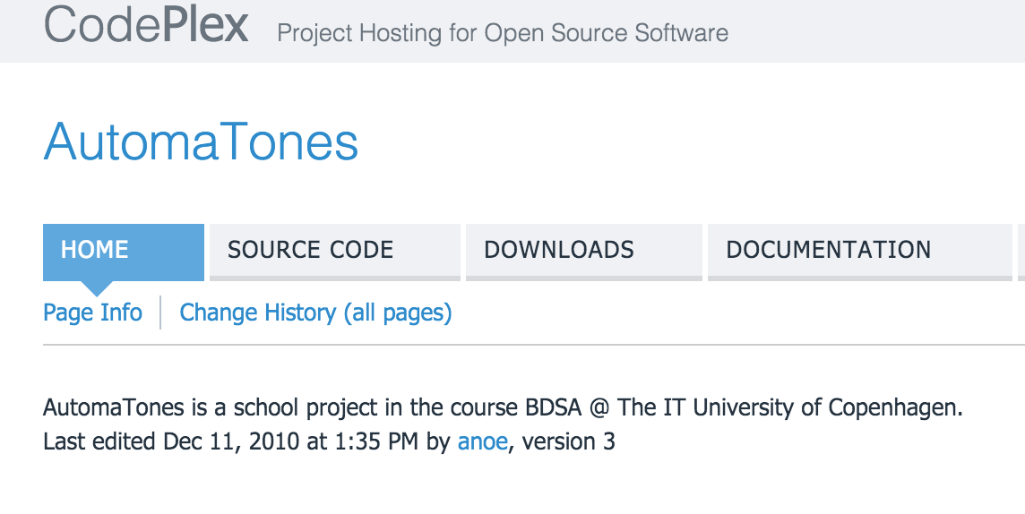
Anomaly Example in Our Subjects
Developers can misunderstand/misuse PUTs as code contracts
http://automatones.codeplex.com/

Slide 16
Research Questions
How extensively are PUTs used?
How are CUTs used over PUTs? What motivations do developers have to use one over the other?
How frequently are non-primitive parameters supplied to PUTs? What is the percentage of non-primitive types and parameters associated with factory methods?
Notes:
auto-test generation tools face high difficulty in generating desirable object states for nonprimitive parameters, they are expected to write factory method themselves

Slide 17
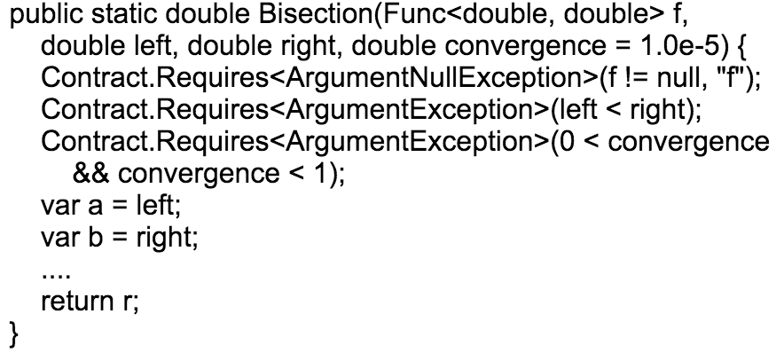
How extensively are PUTs used?
On average 49.2% of public methods are tested with PUTs
Methods not tested with PUTs are commonly helper methods or methods that are using code contracts

Slide 18
How extensively are PUTs used?
On average 49.2% of public methods are tested with PUTs
Methods not tested with PUTs are commonly helper methods or methods that are using code contracts

Slide 19
How extensively are PUTs used? - Statistics

Slide 20
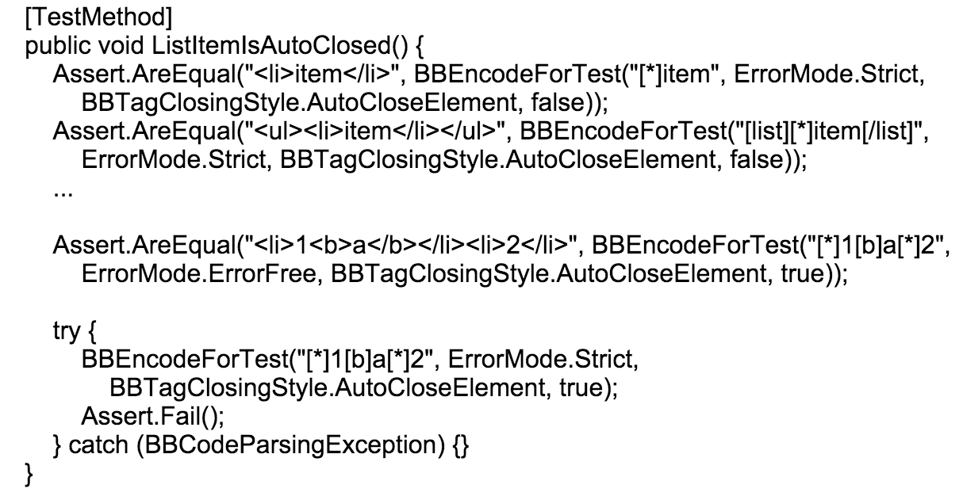
How are CUTs used over PUTs?
Average test method length
PUTs: 12.9 lines
CUTs: 13.9 lines
CUTs are longer because developers write test code to produce a specific input

Slide 21
How frequently are non-primitive parameters supplied to PUTs?
32.26% of non-primitive parameters in PUTs are uniquely typed
Only 9.11% of non-primitive parameters in PUTs are associated with factory methods
Developers rarely write factory methods
Notes:
Pex produce naïve factory methods, developers are expected to write their own.
Developers don’t understand the importance of writing them themselves
Poor education, not good skills to write them…

Slide 22
Threats to Validity
Construct Validity - use of our chosen metrics to model our desired properties
Internal Validity - complexity of software, faults in our analysis tools
External Validity - our conclusions when applied to other subjects
Notes:
Construct Validity - use of our chosen metrics to model our desired properties
Used number of clauses contained in a specification to model its strength. This is an approximation to the actual strength of a specification
Internal Validity - complexity of software, faults in our analysis tools
analysis tools written with an associated suite of unit tests
External Validity. - our conclusions when applied to other subjects
Subjects use Microsoft Pex, framework for writing their parameterized unit tests
All of our subjects are written in C#, but vary widely in their application domains and project size
Open source software -> may not generalize to industrial software systems

Slide 23
Conclusion
Specification through code contracts and invariants are difficult
Parameterized unit testing is a lightweight specification methodology
Major findings: there exist cases of
Misusing/misunderstanding the use of PUTs
Not fully leveraging PUTs when specific inputs are hardcoded
Factory methods not sufficiently written to assist test generation tool
More findings are in our paper draft under submission

Slide 24
Thank you! Any questions?

Slide 25
Conclusion
Specification through code contracts and invariants are difficult
Parameterized unit testing is a lightweight specification methodology
Major findings: there exist cases of
Misusing/misunderstanding the use of PUTs
Not fully leveraging PUTs when specific inputs are hardcoded
Factory methods not sufficiently written to assist test generation tool
More findings are in our paper draft under submission

